Slide 1
The Big Debate
Understanding, Responding
Ages 11-13, Ages 14-18

Slide 2
The Big Debate
Timing: 30 minutes
Learning outcomes:
Learners will be able to:
Consider the motives behind different online behaviours.
Evaluate the issues and risks around the right to online expression and privacy.
Key vocabulary: victim-blaming, rights, privacy, freedom, expression, trolling, harassment, protection, expectations, responsibility.
Resources: Pens, paper

Slide 3
Key Questions
Is everyone treated the same online? Why/why not?
Does everyone have the right to…
...privacy?
...freedom of expression?
...protection from harm?
Does someone put themselves at greater risk if they share/post their photos publicly online?
Why/why not?
If so, what risks might they face?
Should someone expect to get a negative reaction about their photos from others online?
Is this fair?
Is it ever deserved?
What about public figures (celebrities, politicians, influencers, etc.)?
Are there sufficient laws to tackle cyberbullying?
Does the internet industry do enough to protect their users from cyberbullying?
What can someone do to protect themselves from cyberbullying, harassment or hate online?
Behaviour strategies
Technical strategies
Strategies to seek help/support

Slide 4
Introducing the statement
If you don’t want people to leave nasty comments on your photos, then you shouldn’t post your photos online…
Agree or disagree?
We are going to hold a debate on the following statement:

Slide 5
Holding the debate
You will split into two teams - Agree and Disagree.
You have 10 minutes to prepare your argument and select 1-3 speakers to represent your team in the debate.

Slide 6
Themes to consider
Agree | Disagree
Should negative comments be expected online? Is this just freedom of expression? Is this behaviour ever justified? Does it come down to personal choice? Does privacy exist online? Are expectations the same for all groups of people e.g. young people, adults, men/women, figures in the public eye? How could someone protect against this treatment? | Is this behaviour ever justified? What are the risks of sharing images online? Who is responsible for this behaviour? Should there be stronger laws? Should social media companies do more? Is privacy and safety more important than the right to express yourself freely? How could someone protect against this treatment?

Slide 7
Time to vote...
If you don’t want people to leave nasty comments on your photos, then you shouldn’t post your photos online…
Agree or disagree?

Slide 8
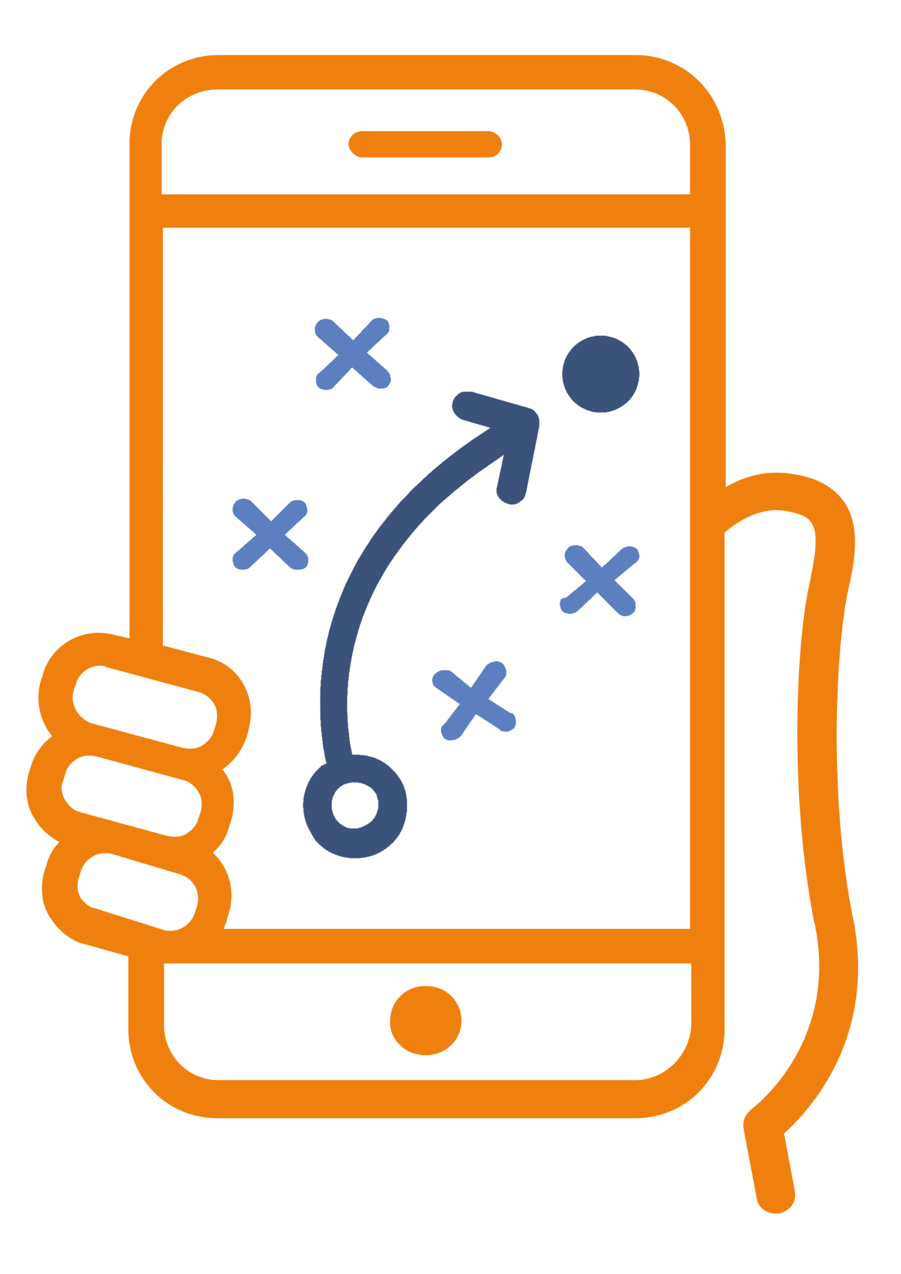
Personal strategies
Record as many strategies as you can think of for an online user to protect themselves or others from online bullying, harassment or hate:
Behavioural strategies (choices that a user makes with regards to what they create/post/share online)
Technical strategies (online/digital tools that can aid users e.g. privacy settings)
Strategies to seek help/support (e.g. reporting tools, helplines, etc.)

