Slide 1
Defining Cyberbullying
Understanding
Ages 11-13, Ages 14-18

Slide 2
Defining Cyberbullying
Timing: 25 minutes
Learning outcomes:
Learners will be able to:
Identify the key characteristics of cyberbullying behaviour.
Contribute to a class/group agreed definition of cyberbullying.
Key vocabulary: cyberbullying, bullying, threaten, target, repeated, purposeful, harassment, discrimination, stereotypes, well-being, hate speech, human rights, illegal.
Resources: Sticky notes, large sheets of paper, pens.

Slide 3
Key Questions
What do you think cyberbullying is?
How can cyberbullying occur and who is involved?
How can cyberbullying make someone feel?
Is something still cyberbullying if the person targeted isn’t affected?
What are the key features of cyberbullying?
How would you define cyberbullying?

Slide 4
Inside the mind of a bully
Imagine you are a bully.
How many different ways can you think of to bully someone using the internet and technology?
Record your ideas on your sheet of paper.

Slide 5
Inside the mind of a bully
Photos
Audio messages
Edited images
Fake web pages
Videos
Memes
Public messages
Coded messages
Private messages
Spreading rumours
Exclusion
Fake accounts
Hate speech
Harassing behaviour

Slide 6
Do we agree?
“Cyberbullying refers to intentional and repeated harm that others inflict via a digital device.”
(Hinduja and Patchin, 2009)
There is no commonly agreed definition of cyberbullying.
This definition comes from the KidActions research report.
Do you agree with this definition?

Slide 7
Our shared definition
Let’s create a definition we all agree on:
Cyberbullying is…

Slide 8
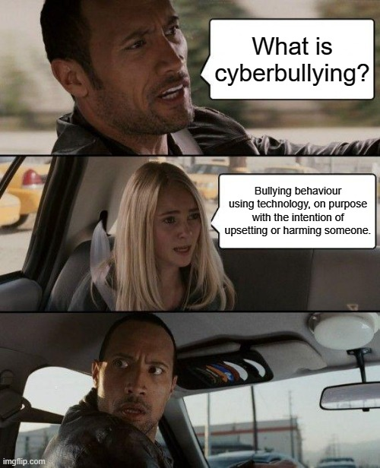
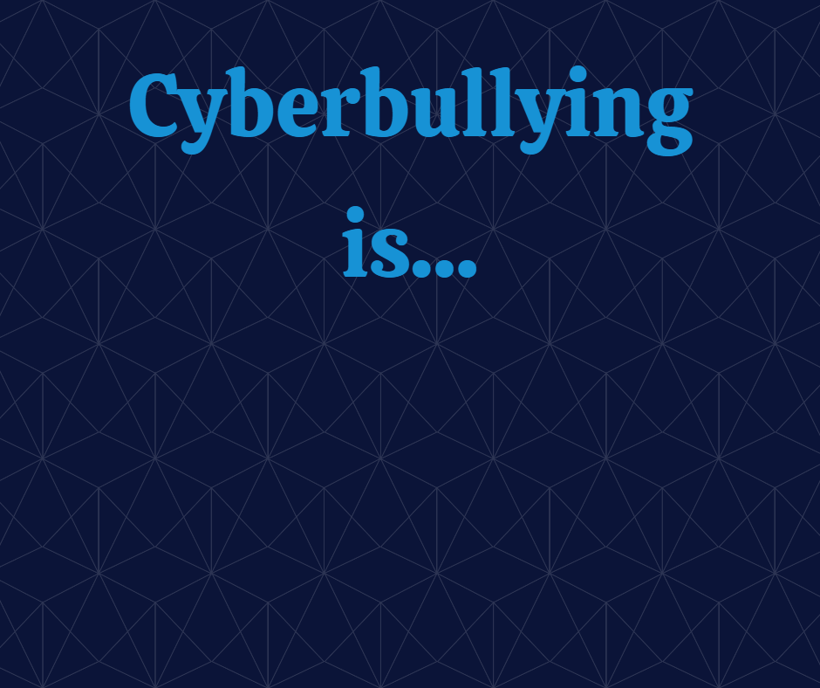
How can we remember?
What could you create or do to help you remember our shared definition?

