Slide 1
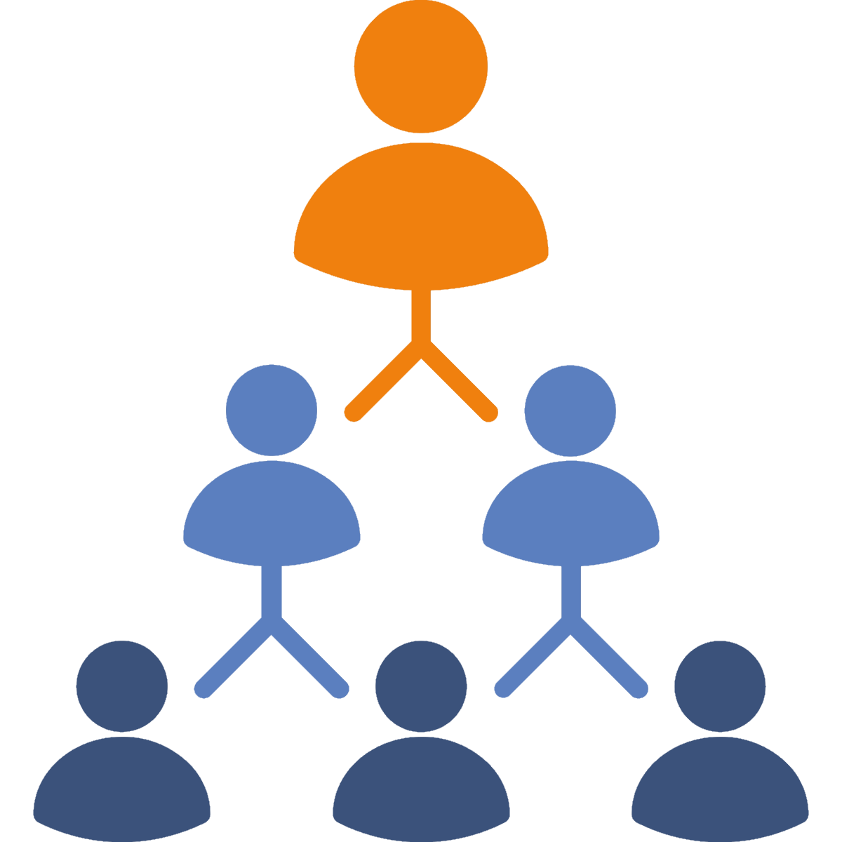
Who’s on my team?
Preventing, Responding
Ages 11-13, Ages 14-18

Slide 2
Who’s on my team?
Timing: 25 minutes
Learning outcomes:
Learners will be able to:
Identify key members of the community who can provide support with cyberbullying problems.
Key vocabulary: community, support, assistance, upstander, responsibility, trust, responding.
Resources: Circles of Action worksheet (slide 5)

Slide 3
Key Questions
If you had a problem, who could you turn to…
...inside school?
...outside school?
...online?
Who would you ask for help if you were being cyberbullied?
Why?
What actions would you expect them to take?
Who would you ask for help if someone else was being cyberbullied?
Why?
What actions would you expect them to take?
Which members of your community could help prevent cyberbullying?
What actions would you want them to take?
What role do you think you play in your group/community to help prevent or respond to cyberbullying?
E.g. someone who directly intervenes/mediates, someone who can seek help for others, someone who gives advice, someone who shows empathy and listens to the target, etc.

Slide 4
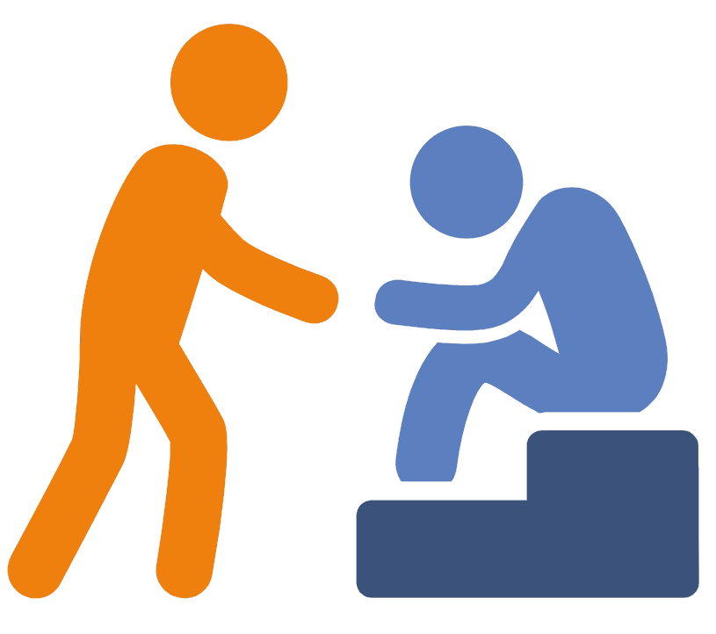
Who can help?
Make a list of anyone who could help you in a cyberbullying situation.
Consider:
People in school who can help
People outside of school who can help
People online who can help
Organisations/helplines

Slide 5
Circles of action

Slide 6
Circles of action
Preventing
Cyberbullying
Responding to
Cyberbullying

Slide 7
Circles of action
Online actions
Offline actions

Slide 8
What’s your role?
How can you help someone in a cyberbullying situation?
What actions can you take…
...online?
...offline?

