Slide 1
From Negative to Positive
Preventing, Responding
Ages 11-13

Slide 2
From Negative to Positive
Timing: 40 minutes
Learning outcomes:
Learners will be able to:
Understand how cyberbullying can be challenged through positive use of language.
Evaluate the benefits and risks of intervening in a cyberbullying situation.
Key vocabulary: language, banter, negative, positive, intervene, challenge, upstander, bystander, benefits, protect, risks, support.
Resources: High School Superhero game

Slide 3
Key Questions
How would you challenge someone expressing hurtful or harmful views…
...offline?
...online?
If you saw someone being verbally bullied, would you intervene?
How would you intervene offline?
How would you intervene online?
What are the benefits of intervening or being an upstander?
What are the risks of intervening?
How do these risks differ between online and offline?
What could be the outcome of successfully intervening? (What would you like to see happen next?)
What advice do you have for safely challenging cyberbullying?
What advice do you have for someone who wants to help but doesn’t feel they can directly challenge a bully?

Slide 4
Flipping the negatives
Consider the negative words and phrases that a cyberbully may use towards someone else.
For each, write down a positive alternative.
Create a list of positive words/phrases.

Slide 5
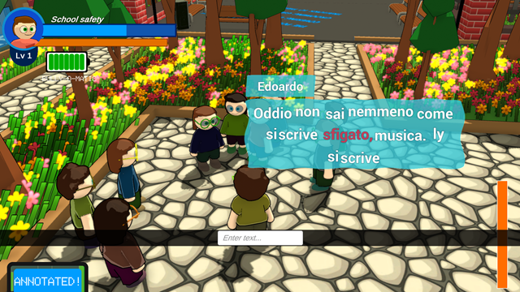
Be a High School Superhero!
Play the game and use your positive word list to change the bully’s negative speech.
You may have to consider other positive words/phrases as well.

Slide 6
Reflection
Think about the concept of flipping language from positive to negative in the game:
Did it have the desired effect?
Would asking/telling/reasoning with a bully to rephrase their negative sentiment to a positive one work online or offline?
Why/why not?
Do you see any issues in changing someone else’s words, even if they are unkind or hateful?
How could you use this technique of flipping language online? (e.g. respond to a negative message with a positive one.)
How might your positive behaviour affect other users? (e.g. the bully, the target, other users who witness the cyberbullying.)

Slide 7
Positive intervention
What are the benefits of intervening or being an upstander?
What are the risks of intervening?
How do these risks differ between online and offline?
What would you like to see happen as a result of a successful intervention?

Slide 8
What’s your advice?
What is your advice for...
...someone who wants to safely challenge cyberbullying?
...someone who wants to help but doesn’t feel they can directly challenge a bully?

