Slide 1
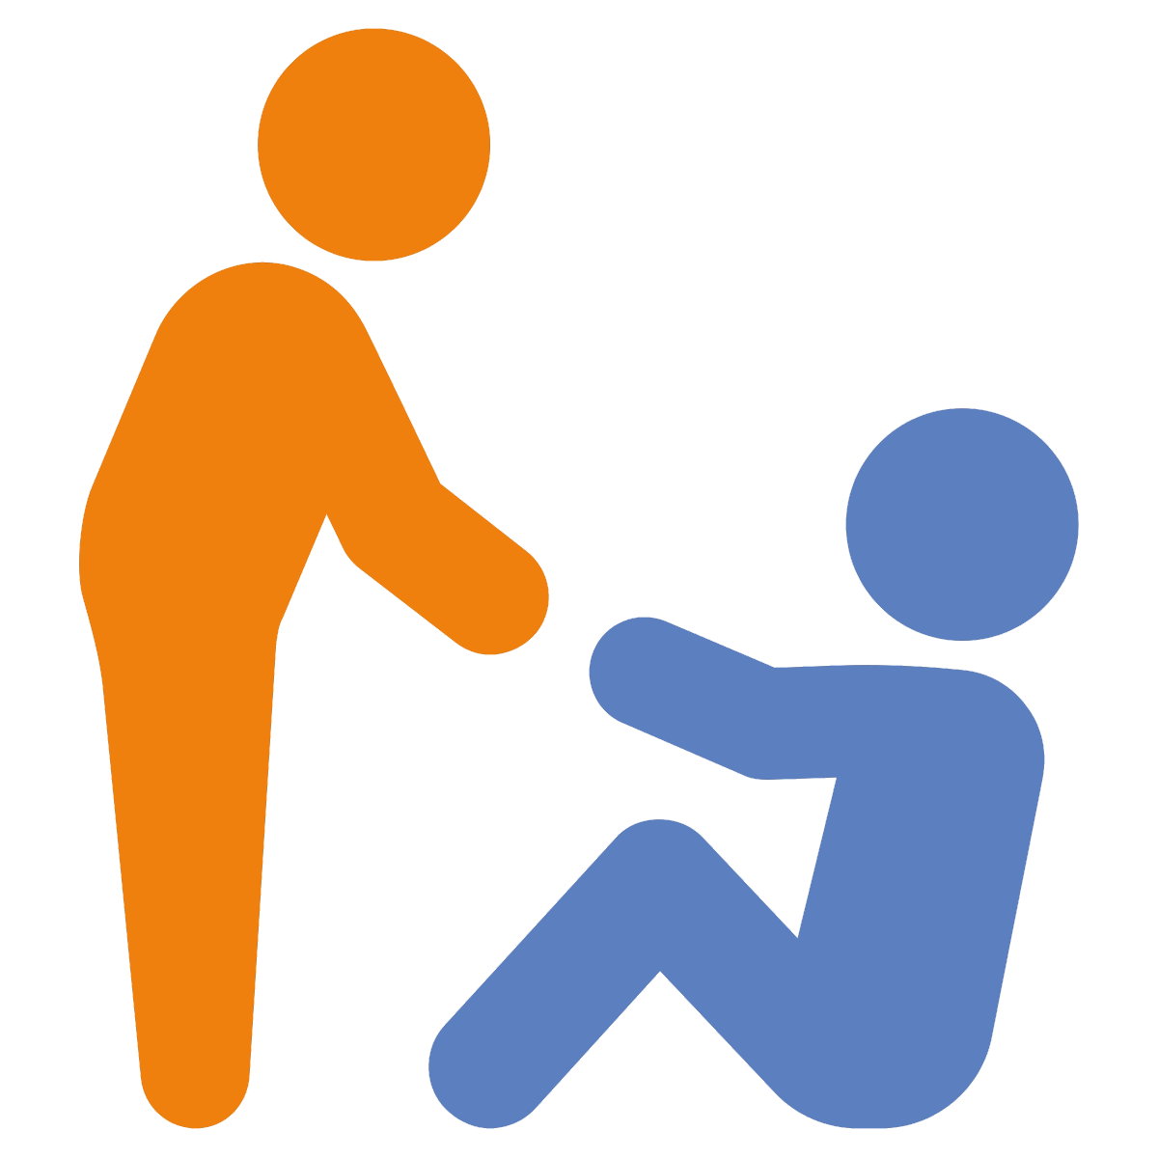
Stepping in
Preventing, Responding
Ages 11-14, 14-18

Slide 2
Stepping in
Timing: 45 minutes
Learning outcomes:
Learners will be able to:
Recognise how different online situations make them feel.
Identify how others might feel in these online situations.
Evaluate how bullying interventions can have positive or negative consequences depending on context and timing.
Key vocabulary: cyberbullying, emotions, regulation, strategies, intervention, bystander, upstander, positive, negative, consequence, impact.
Resources: ‘Considering responses’ worksheet (slide 6)

Slide 3
Key Questions
Which emotions are high/low intensity?
How do you feel when you see someone else being bullied online?
Do you feel differently if it is someone you know/don’t know personally? Why?
How might others be feeling in that situation?
How do our emotions change the way we respond to difficult situations?
Which emotions lead to better outcomes?

Slide 4
10
Emotion sorting
Relaxed
Excited
Bored
Annoyed
Anxious
Disgusted
Furious
Disappointed
Worried
Miserable
1
Surprised
Consider these emotions.
How intense are they on a scale from 1 (least intense) to 10 (most intense)?

Slide 5
How would you feel?
A player is sent repeated homophobic insults in a game because of how their avatar/character looks.
A fake social media profile is set up pretending to be someone from your school, saying things about them that aren’t true.
Using the emotions from the previous activity (or ones of your own choice), how would you feel if you saw these situations online?
How might the person on the receiving end feel?
Your best friend receives daily messages from someone online calling them ‘ugly’.
Someone in your class keeps getting anonymous phone calls in the middle of the night. When they answer, all they hear is laughter or growling.

Slide 6
Considering responses
What might happen next?
You say/do…
You feel…
Your best friend receives daily messages from someone online calling them ‘ugly’.
Intense
Less intense

Slide 7
Positive pathways
Look again at your pathways. Which pathways lead to a positive outcome and which lead to a negative outcome?
Which is your ‘best’ pathway?

