Slide 1
Take a meta-moment
Understanding, Preventing, Responding
Ages 11-14, 14-18

Slide 2
Take a meta-moment
Timing: 30 minutes
Learning outcomes:
Learners will be able to:
Consider emotional regulation strategies to shape responses to cyberbullying.
Develop effective regulation strategies to protect themselves and others online.
Key vocabulary: cyberbullying, emotions, personality, regulation, strategies, pause, consider, reflect, best-self, meta-moment.
Resources: ‘Meta-moment’ cards (slide 6)

Slide 3
Key Questions
Do you behave differently when you feel…
…angry? How?
…upset? How?
…excited? How?
…happy? How?
How can you change your emotions?
What do you do to calm down (or regulate)?
What are the top three things you would do in order to be your ‘best self’?

Slide 4
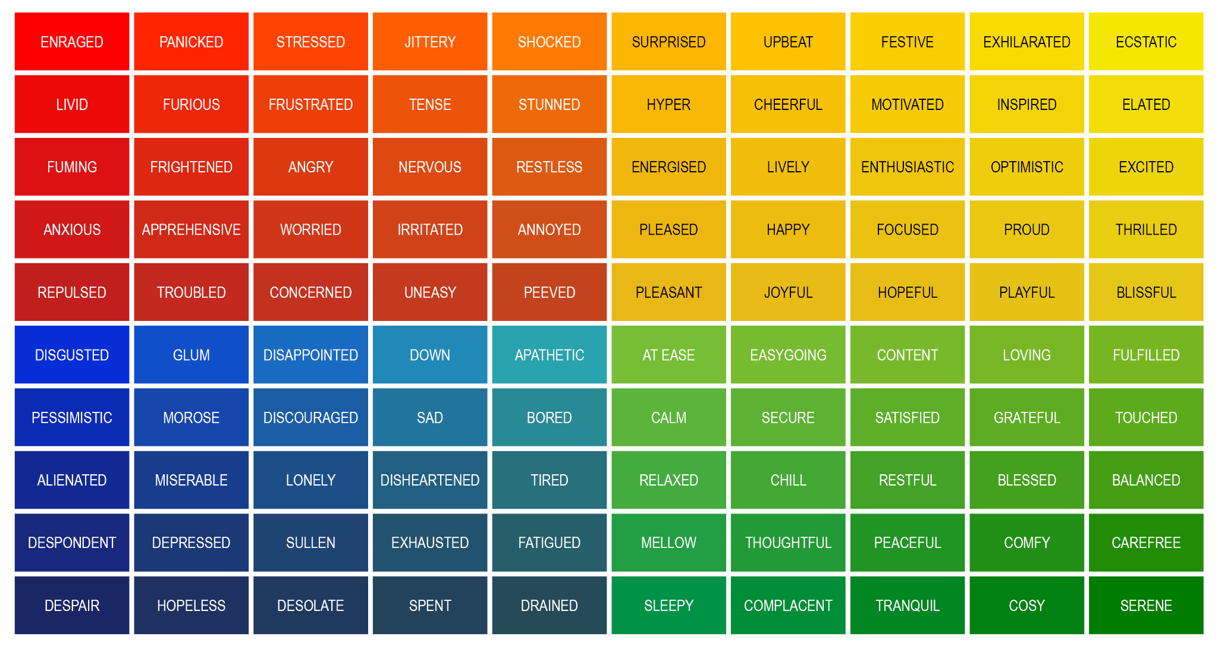
How do you feel online?
Select an emotion and consider a time online when you felt that way.

Slide 5
Meta-moments
A break or pause in order to consider your emotions and use strategies to regulate your emotions.
This can help you make decisions as your ‘best self’.

Slide 6
Meta-moment cards
My meta-moment strategies:
My meta-moment strategies:
My meta-moment strategies:
My meta-moment strategies:

Slide 7
Meta-moment strategies
Short term:
Breathing
Mindfulness/relaxation
Reframing
Private self-talk
Visualisation
Distraction
Distance yourself
Longer term:
Take positive action
Meditation
Physical activity
Hobbies/activities
Change the situation
Seek support
Find solutions
Set goals
Get professional help

Slide 8
Your best self
What would your ‘best self’ do to tackle cyberbullying?

