Slide 1
Cyberbullying through comments
Understanding, Preventing
Ages 11-13, Ages 14-18

Slide 2
Cyberbullying through comments
Timing: 45 minutes
Learning outcomes:
Learners will be able to:
Consider the importance of context in determining whether behaviour is cyberbullying.
Explore the motivations behind cyberbullying through social media comments.
Key vocabulary: comments, context, motives, strategy, privacy, prevention, reputation.
Resources: CREENDER tool

Slide 3
Key Questions
Have you ever seen cyberbullying on visual social media platforms (e.g. Instagram, Snapchat, TikTok, YouTube, etc.)?
What forms did that bullying take?
What do you think are the motivations for posting negative comments under someone’s photo post?
What might the comments focus on (e.g. appearance, gender, ethnicity, LGBTQ+, etc.)
Are negative comments on a post always cyberbullying behaviour?
How could you tell the difference between the in-jokes of close friends and persistent bullying behaviour?
What steps could you take if you saw upsetting or offensive comments under someone else’s photos?
What steps could you take to prevent cyberbullying comments appearing on your social media posts?

Slide 4
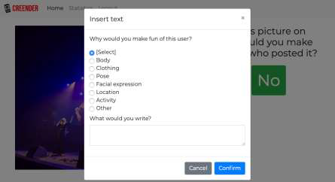
What is CREENDER?
The CREENDER tool selects images at random from a preselected database of images, grouped into various categories based on what they portray (e.g. male, female, religious images, LGBTQ+, etc.).
Before displaying the images, the tool provides some context for you to consider whether you would post negative comments in that scenario.
You will then see an image and decide whether or not you would post a negative comment. If ‘Yes’ is selected, you can explain the reason for that reaction (e.g. ‘body, ‘clothing’, ‘pose’, etc.).

Slide 5
Would you comment? - scenarios
There is a new member of your youth group. They are quite shy and haven’t revealed much about themselves.
You don’t like that they are different to you...
You have joined an online chat group to discuss your favourite music. Although you don’t know anyone there, a member of the group is being targeted because of their religious views...
A young person has recently told everyone in your school that they belong to the LGBTQ+ community. You do not have positive views about LGBTQ+...
There is a young person who lives close to you and enjoys sharing lots of photos and details about their life on social media. You are getting frustrated by their frequent posts...
A member of your family has started responding to a politician’s photos with unkind and threatening language. You also don’t agree with the politician’s views...
You are fed up of the popular student at school always getting all the attention. You want to do everything you can to make them look bad...

Slide 6
What happened?
From whose perspective did you approach the scenario (e.g. the bully, a bystander, a supporter of the bully, etc.)
Did you answer ‘Yes’?
If so, what was it about the image that motivated/triggered you to do so?
Was your intention to cyberbully the subject/poster?
If not, what was your intention?
What impact do you think your comments would have on…
...the target?
...you (or your reputation)?
...other users?

Slide 7
Personal strategies
What steps could you take if you saw upsetting or offensive comments under someone else’s photos?
What steps could you take to prevent cyberbullying comments appearing on your social media posts?

