Slide 1
Who are your role models?
Preventing, Responding
Ages 11-14, 14-18

Slide 2
Who are your role models?
Timing: 40 minutes
Learning outcomes:
Learners will be able to:
Consider the characteristics/qualities of positive role models.
Identify role models from local and online communities.
Explain how these role models can help to prevent cyberbullying.
Key vocabulary: cyberbullying, characteristics, traits, qualities, role model, inspiring, community, prevention.
Resources: ‘Role model Top Trumps’ template (slide xx)

Slide 3
Key Questions
What is a positive role model?
What characteristics or traits might they possess?
What makes people look up to them?
Who are your role models in…
…your local community?
…your school?
…your online groups/spaces?
Why are these people role models to you?
What could the actions and words of these role models teach us about how to deal with cyberbullying?

Slide 4
What makes a role model?
What is a role model?
What qualities do they possess?

Slide 5
Qualities of a role model
Morals
Behave ethically and honestly.
Confidence
Acknowledge own skills and take pride.
Hardworking
Show commitment, perseverance and dedication.
Respectful
Show respect for others, selflessness and avoid prejudice.
Optimism
Show an upbeat and positive outlook, even in adverse situations.

Slide 6
Who are your role model?
They could be…
a trusted adult
a member of staff at school
an inspiring member of our local community
an online influencer who promotes positive messages and behaviour
an online user who you look up to.

Slide 7
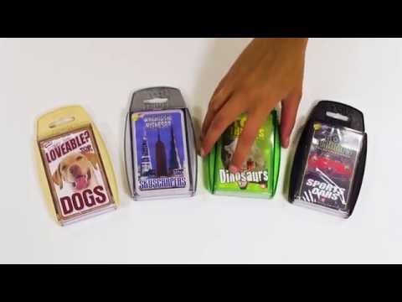
Top Trumps

Slide 8
Role Model Top Trumps
Role Model
Top Trumps
What can this person teach us about dealing with cyberbullying?

Slide 9
Time to play!
Using the group’s Top Trumps cards, have a game and see what you can learn from your role models about tackling cyberbullying!

